Slide 1
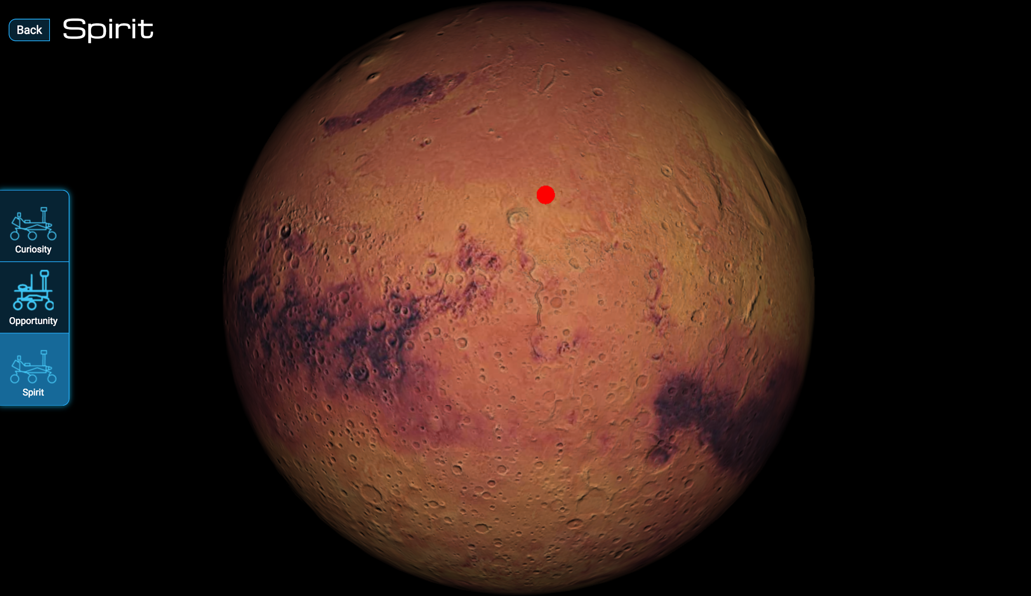
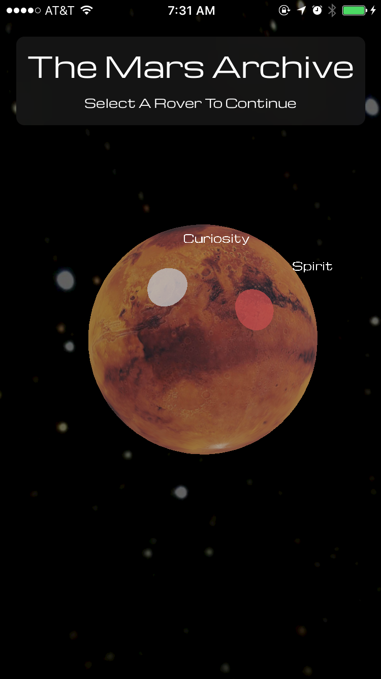
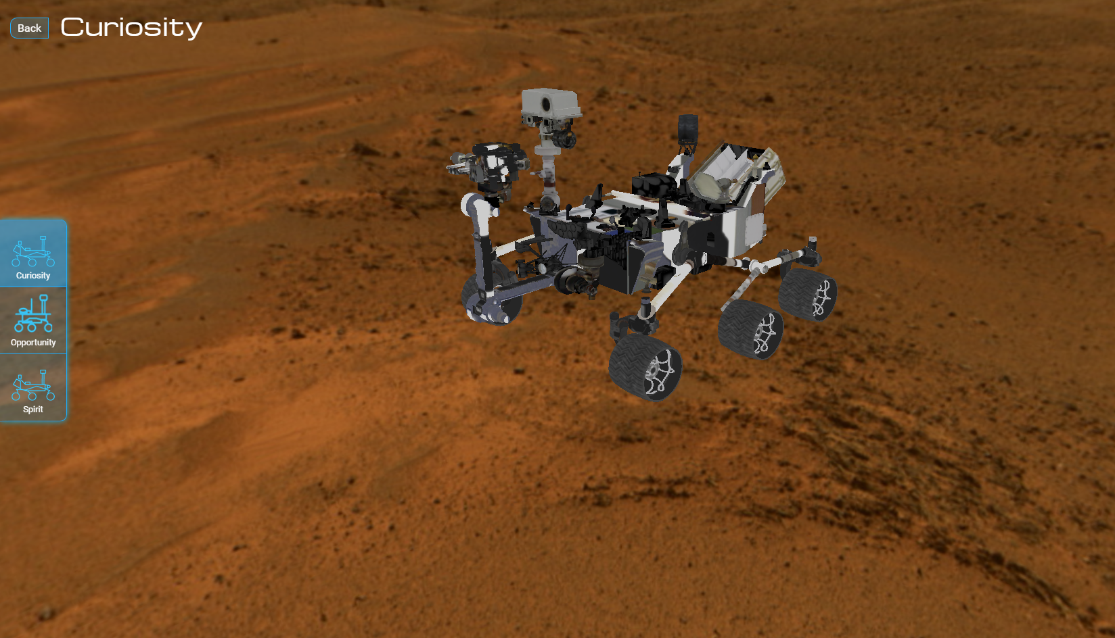
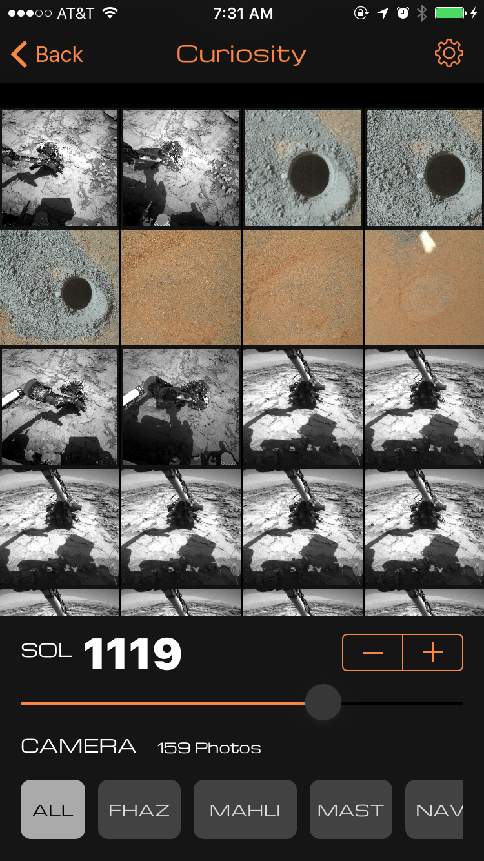
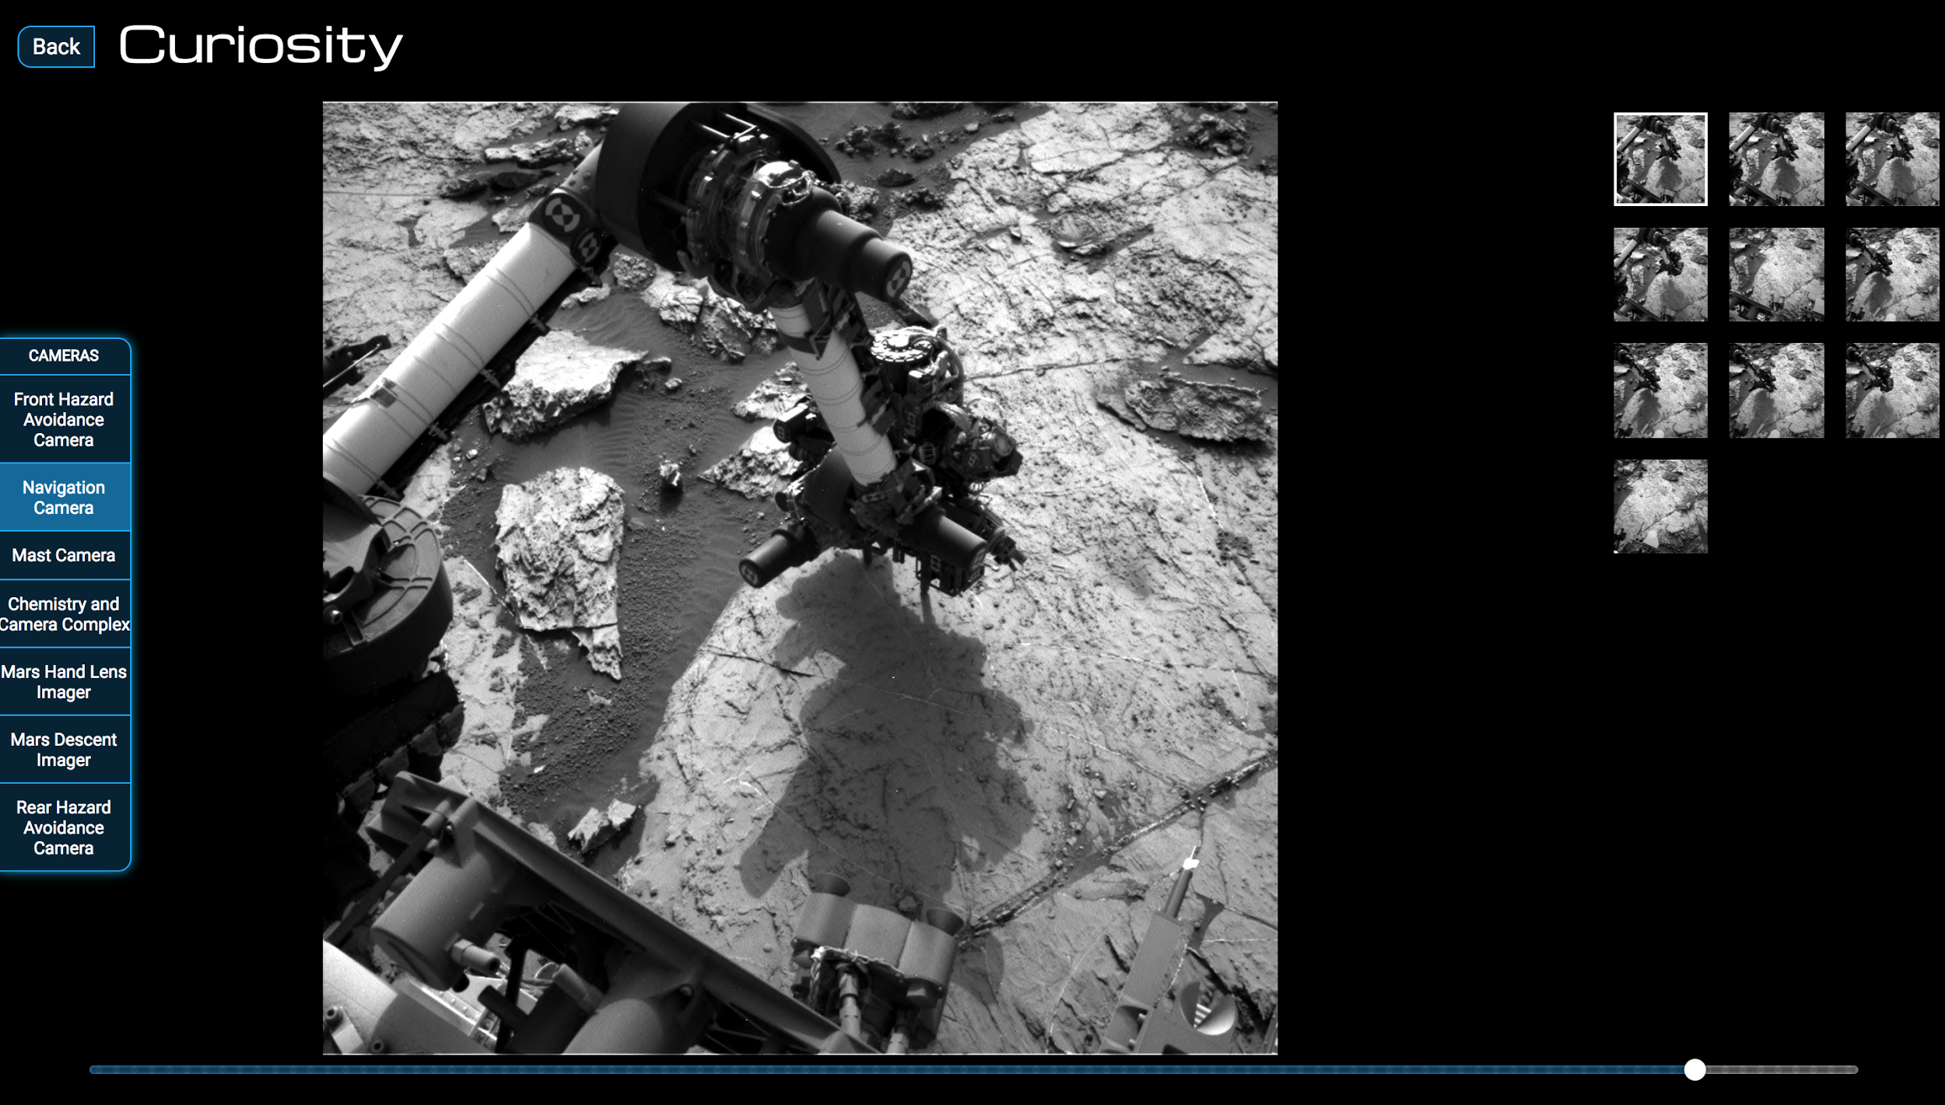
Summary
Salty Farmers: Vengeance
Two Components = One Seamless Experience
Web Application
iOS Application
3D Mars / Rover Models
Shows location of Rovers
High performance on both platforms

